Slide 1

Intern to Hire
VFM – Pathway to a Solution Selling career
Notes:
Welcome to the Cisco Identity Services Engine – or ISE – presentation for technical decision makers.

Slide 2
Company Overview
25 years in Business with above industry average bottom lines
Solution selling approach
Account focus with 80% repeat business
Long term relationships , with some over 15 to 18 years and still going
We choose business that we will execute

Slide 3
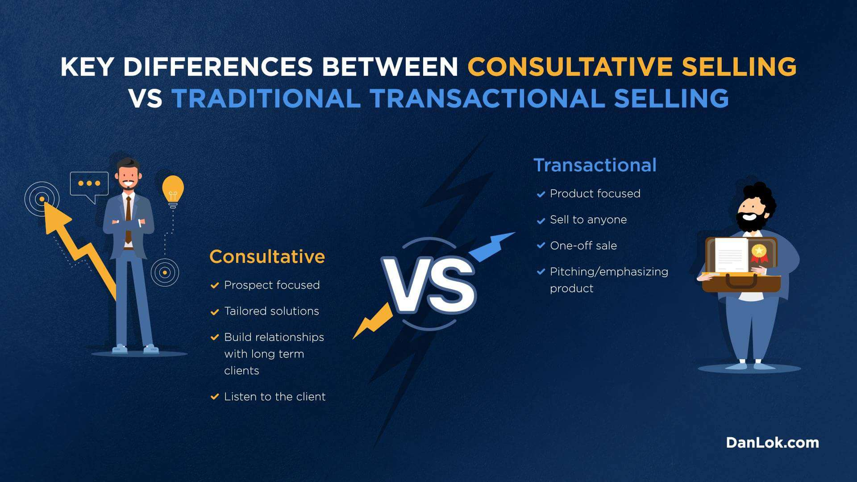
How does Solution Selling approach add to your sale ability quotient
Customer looks upon salesperson as consultant
Early in the sales cycle can drive sales opportunity rather than
follow
Continuous learning and unlearning cycle amidst technology
churn
Higher bottom lines realized , better earnings
Ability to solve problems helps customer better customer recall

Slide 4

Value addition through assignment
Solution sales specialist
Consultant rather than salesman
Value selling leads to better customer recall , stronger connects
Solution selling = Strategic selling means meeting CXOs / Middle to Senior IT management
Build strong technical edge to selling

Slide 5

Cybersecurity
Next Gen firewalls
Next gen Endpoints
Threat hunting and Intelligence
Security Orchestration and Automation
Cloud security
SASE and Work from home
SAAS based email security

Slide 6
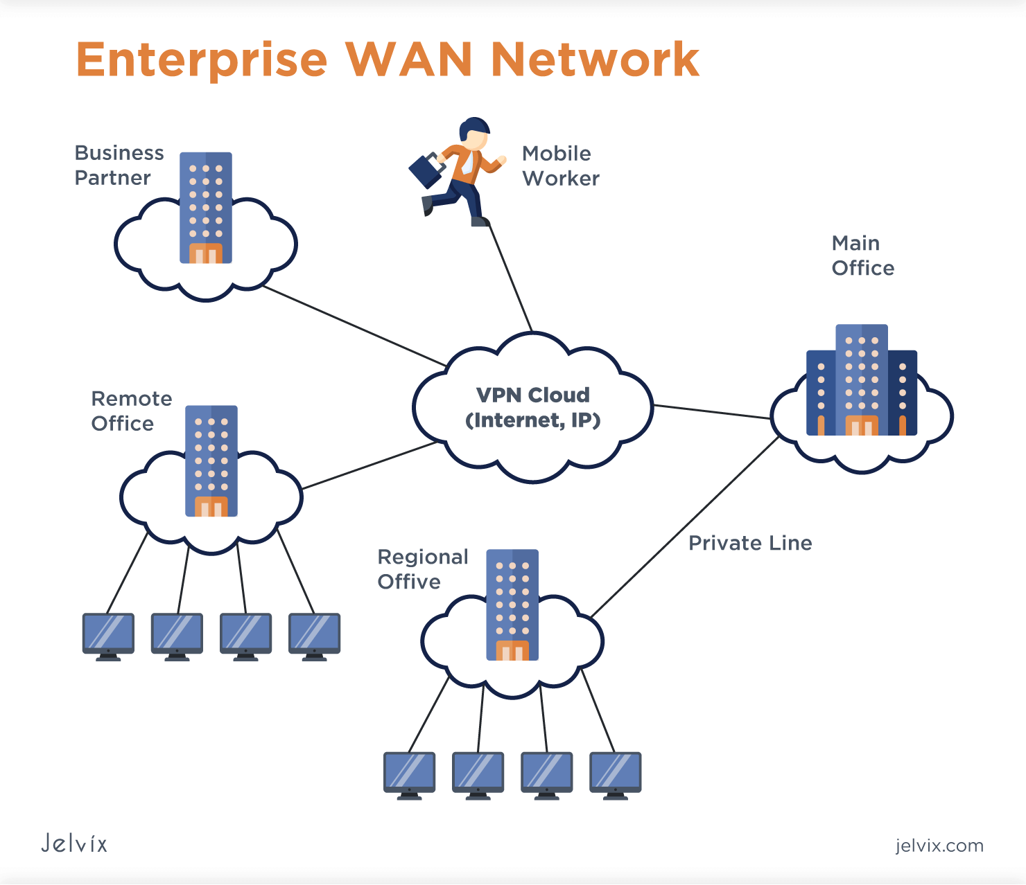
Enterprise Networking
Enterprise Wifi
Wireless design for e-tailing/warehouses
Enterprise QOS across WAN
NAC ( network admission control )
Network operations management

Slide 7
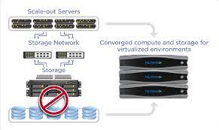
Data Centre and Compute
Hyperconvergence
Enterprise backup
Cloud backup
PAM( privilege access management )
DAAS ( VDI as a service)
Cloud Ops optimization
Asset management

Slide 8

Job Description
Job Description
The selected candidate is expected to cover the assigned territory – prospecting, developing and advancing generated opportunities through the funnel stages to closure.
Map the potential target accounts in the assigned territory.
Meet the key decision makers for our solutions in the target accounts i.e. the IT Manager, Networking Manager, Security Manager, Data Centre Manager, Cloud Manager etc. and pitch for business and generate pipeline.
Develop consultative relationships with the people described above in the target accounts.
Work with Presales, Technical and Sales Manager, OEM sales teams to build adequate pipeline commensurate with business targets given and advance cases through the funnel stages to closure.
Maintain healthy addition to pipeline by sound coverage of the assigned territory.
Develop and deepen key account relationships by involving senior managers in meetings with key decision makers in the account(s).
Achieve the assigned revenue and profitability goals quarter on quarter.

Slide 9

B2B SALES Internship
Learn New skills
Practice with real prospects customers
Get mentored by Senior professionals in the industry.
Understand result-oriented work.
Exposure to modern tools and technologies
Understand business processes

Slide 10
Intern to Hire
The Internship program is for a period of 6 months
Interns gain valuable practical experience and industry insights
Interns have the opportunity to understand the company's culture and work style
Interns will work on the Sales ssignments relevant to the company's needs, under the guidance of experienced employees
During the Internship program the candidate will be eligible for a fixed Stipend
Interns are typically evaluated on their performance, work ethic, and contributions to the team
Based on the evaluation, successful interns will be offered a full-time position at the company post their graduation

Slide 11
Thank You

